Slide 1

UECS3213 / UECS3453 Data Mining Topic 3a: Classification (Part 1): kNN, Decision Tree Classifier
Dr. Simon Lau Boung Yew

Slide 2
Course Learning Outcomes
CO1: Identify the key technological foundations of data mining
CO2: Create programming solutions using data mining techniques for given problem
CO3: Evaluate performance of data mining solutions for a given problem
CO4: Construct a data mining project as a team
CO5: Recognize the importance of data mining techniques and its applications in the industry

Slide 3
Outline
Supervised vs Unsupervised Learning
What is classification?
Examples of Classification Tasks
Classification Techniques
Part 1:
K-Nearest Neighbours (k-NN)
Decision Tree Classifier
Part 2:
Naïve Bayes Classifier
Support Vector Machine (SVM)
Ensemble Methods
Part 3: Classification Performance
Confusion Matrix
Model Evaluation Methods
Receiver Operating Characteristic (ROC) Curve

Slide 4
Outline
k-NN
Definition
Examples
Strength
Weaknesses
Decision Tree Classifier
Definition
Examples
Decision Tree Induction Algorithms
Measure of Node Impurity
Strength
Weaknesses

Slide 5
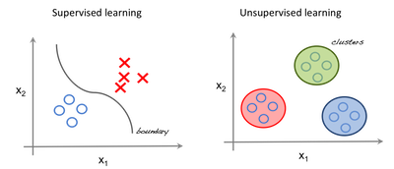
Supervised vs Unsupervised Learning
Supervised
Input data is labelled (class is known)
Develop predictive model based on both input and output data
Task well-defined (the target function)
Unsupervised
Input data is not labelled (class is not known)
Interpret data based on input data only
Task vaguedly defined

Slide 6
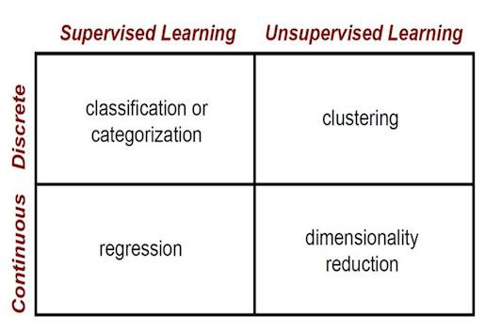
Supervised vs Unsupervised Learning
(Chapter 3)
(Chapter 5)
(Chapter 4)

Slide 7
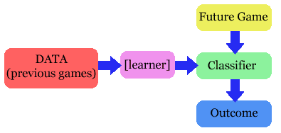
The problem
Given a set of training cases/objects and their attribute values, try to determine the target attribute value (class) of new examples (test case).
Classification
Prediction

Slide 8
Example
Spam Classification
Given an email, predict whether it is spam or not
Medical Diagnosis
Given a list of symptoms, predict whether a patient has disease X or not
Weather
Based on temperature, humidity, etc… predict if it will rain tomorrow or not

Slide 9
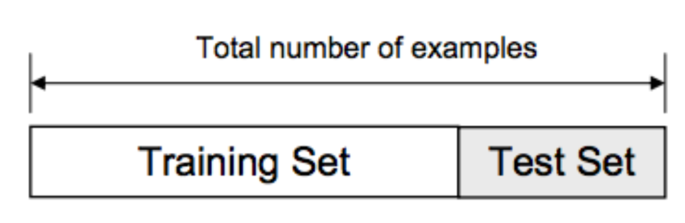
What is classification?
Usually, the given data set is divided into training and test sets, with training set used to build the model and test set used to validate it.
Given a collection of records (training set), each record contains a set of attributes, one of the attributes is the class. Find a model for class attribute as a function of the values of other attributes (training).
Goal: classification: previously unseen records should be assigned a class as accurately as possible
A test set is used to determine the accuracy of the model.
Notes:
https://en.wikipedia.org/wiki/Training,_validation,_and_test_sets

Slide 10
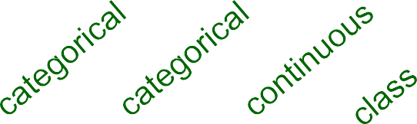
Classification: Example
Tid | Refund | Marital Status | Taxable Income | Cheat
1 | Yes | Single | 125K | No
2 | No | Married | 100K | No
3 | No | Single | 70K | No
4 | Yes | Married | 120K | No
5 | No | Divorced | 95K | Yes
6 | No | Married | 60K | No
7 | Yes | Divorced | 220K | No
8 | No | Single | 85K | Yes
9 | No | Married | 75K | No
10 | No | Single | 90K | Yes
Refund | Marital Status | Taxable Income | Cheat
No | Single | 75K | ?
Yes | Married | 50K | ?
No | Married | 150K | ?
Yes | Divorced | 90K | ?
No | Single | 40K | ?
No | Married | 80K | ?
Training Set
Test Set
10
Test Set
Learn
Classifier
Training
Set
Model
10

Slide 11
Illustrating Classification Task

Slide 12
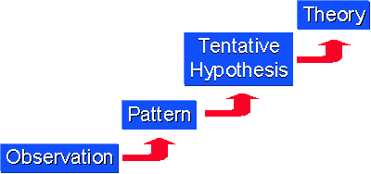
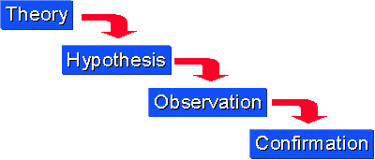
Induction vs Deduction
Induction: from specific observations to broader generalizations and theories.
Training --> model / function
Deduction: works from the more general to the more specific.
Test, classify
Notes:
https://socialresearchmethods.net/kb/dedind.php

Slide 13

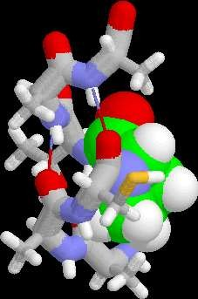


Examples of Classification Tasks
Predicting tumor cells as benign or malignant
Classifying credit card transactions as legitimate or fraudulent
Classifying secondary structures of protein as alpha-helix, beta-sheet, or random coil
Categorizing news stories as finance, weather, entertainment, sports, etc.

Slide 14
Classification Techniques
K-Nearest Neighbours (k-NN)
Decision Tree Classifier
Naïve Bayes (Chapter 3b) and Bayesian Belief Networks
Support Vector Machines (SVM) (Chapter 3b)
Rule-based Methods
Memory based reasoning
Neural Networks
etc.
Notes:
https://www.scribd.com/presentation/146658433/Memory-Based-Reasoning
staffwww.itn.liu.se/~aidvi/courses/06/dm/lectures/lec4.pdf
https://www.tutorialspoint.com/data_mining/dm_rbc.htm

Slide 15
k-Nearest Neighbour (k-NN)

Slide 16
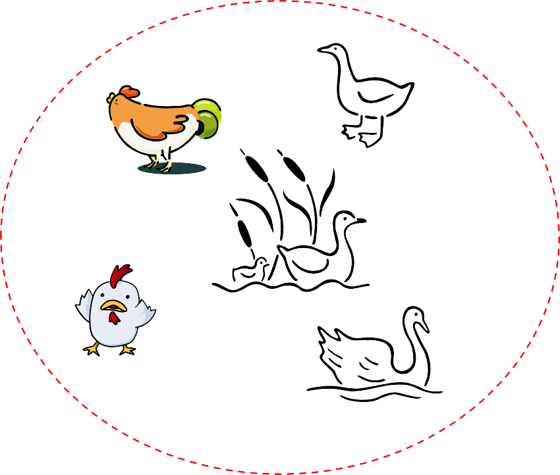

Nearest Neighbour Classifiers
Basic idea: If it walks like a duck, quacks like a duck, then it is probably a duck
Compute Distance
Test Record
Training
Records
Choose k of the
“nearest” records

Slide 17
k-Nearest Neighbour (k-NN)
In k-NN classification, the output is a class membership.
An object is classified by a majority vote of its neighbors, with the object being assigned to the class most common among its k nearest neighbors (k is a positive integer, typically small). If k = 1, then the object is simply assigned to the class of that single nearest neighbor.
Notes:
https://en.wikipedia.org/wiki/K-nearest_neighbors_algorithm

Slide 18
k-Nearest Neighbour (k-NN)
k-NN performs classification by matching the test instance with k training examples and decides its class based on the similarity to the k nearest neighbors. 物以类聚, 人以群分
In k-NN regression, the output is the property value for the object. This value is the average of the values of its k nearest neighbors.
Notes:
https://en.wikipedia.org/wiki/K-nearest_neighbors_algorithm

Slide 19
k-NN

Slide 20
k-NN
A “lazy” classifier. No learning (induction) of model during training.
Store all training instances for testing
The most well-known instance-based learning
Training: record labeled instances as feature vectors (f₁, f₂,..., f_{n})
Test: for a new instance d,
find k training instances that are closest to d. (distance metric (Chapter 2b) is important)
perform majority voting or distance-weighted voting (more in Tutorial 3)

Slide 21
k-NN Algorithm
Determine parameter k
Calculate the distance between the test instance and ALL the training instances
Sort the distances and determine k nearest neighbors
Gather the labels / class of the k nearest neighbors
Use simple majority voting or weighted voting.

Slide 22
Example: Classifying Movies
Task: Classifying movies into romance or action movies
Features/attributes for each movies:
Number of kisses
Number of kicks
6 movies as training dataset
Goal: Given an new movie (test set), tell us whether it is a romance movie or an action movie (classifying task)

Slide 23
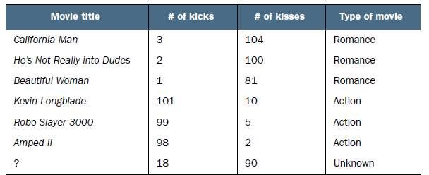
Movie Dataset

Slide 24
Any conventional methods to perform classification?
Heuristics (past experience)
If #kicks > 70 and #kisses < 10, then this is an action movie
else, this is a romance movie
Rote-learner:
Memorizes entire training data and performs classification only if attributes of record match one of the training examples exactly (very hard to do and not practical)
Notes:
Rote-learner

Slide 25
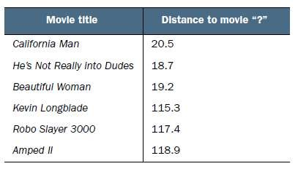
Try another method: Using distance between each movies and movie '?'

Slide 26
K-Nearest Neighbours
Let’s set k=3
Pick top 3 closest movies to Movie ‘?’
Take the majority votes
If the 3 closest movies are majority romance movies, then movie '?' is a romance movie; else, it is an action movie.

Slide 27

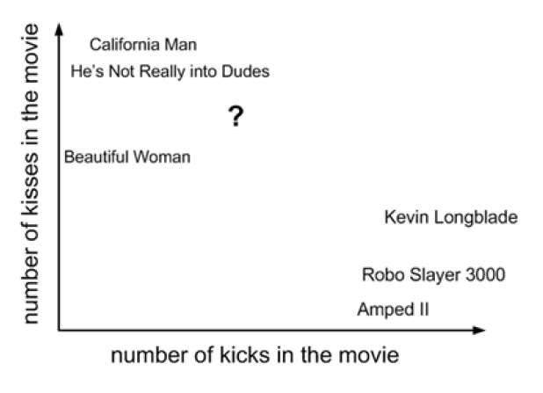
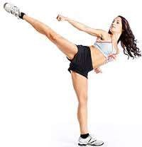
Visualization

Slide 28
Issues
What’s k?
Feature selection: How do we weight/scale/select features?
Imagine there are 100 features, and only 2 of them are relevant to the target label.
Differences in irrelevant features likely to dominate: kNN is easily misled in high-dimensional space.
What similarity / distance measure?
How do we combine instances by voting?
majority voting (fair?)
weighted voting

Slide 29
Picking k
Choosing the value of k (sample size of the nearest neighbours)
If k is too small, sensitive to noise points
If k is too large, neighborhood may include points from other classes (noise)
Choose the right value of k is an art (normally based on some heuristics / past experience)

Slide 30
How do we weight/scale/select features? Scaling Issue
Attributes may have to be scaled to prevent distance measures from being dominated by one of the attributes
Example:
height of a person may vary from 1.5m to 1.8m
weight of a person may vary from 30kg to 100kg
income of a person may vary from $10K to $1M

Slide 31
Scaling Issue: Normalizing attribute values

Slide 32
Issue with Similarity / Distance Measure
Issue with Euclidean distance:
High dimensional data (many attributes): the curse of dimensionality
Can produce counter-intuitive (illogical) results
Solution: Normalize the vectors to unit length
Notes:
https://onlinemschool.com/math/library/vector/length/#h5

Slide 33
Some Similarity Measures

Slide 34
How do we combine instances by voting?
Find the max in knn
Find the max of the
weighted score in knn

Slide 35
Strength
Simplicity (conceptual)
Efficiency at training --> no training
Handling multi-class (more than 1 attribute) problem
Stability and robustness: averaging k neighbours
Effective if the training dataset is large
Robust to noisy training data

Slide 36
Weakness of k-NN
Need to determine the value of parameter k. What is the best k?
k-NN classifiers are lazy learners. It does not build models (recognized relation or function) explicitly (no induction step)
Relatively computationally expensive at testing time: need to calculate all distances to classify unknown records.
Not clear on
which type of distance/similarity metric to use --> distance metrics unclear on non-numerical/binary values
which attribute to use to produce the best results: all or certain attributes only --> sensitivity to irrelevant or redundant features
Notes:
https://en.wikipedia.org/wiki/Lazy_learning
In machine learning, lazy learning is a learning method in which generalization of the training data is delayed until a query is made to the system, as opposed to in eager learning, where the system tries to generalize the training data before receiving queries.

Slide 37
Summary of k-NN
Given a test instance x
Calculate the distances between x and all the training data
Choose the k nearest neighbors
Let the neighbors vote
majority vote
weighted vote
Decide k, feature weights and similarity / distance measure

Slide 38
Decision Tree Classifier

Slide 39
Decision Tree Classifier
Decision tree induction is the task of taking a set of pre-classified instances (training set) as input, deciding which attributes are best to split on, splitting the dataset, and recursing on the resulting split datasets until all training instances are categorized (predictive model formulation).
Decision tree learning (deduction) uses a decision tree (as a predictive model) to go from observations about an item (test set, represented in the branches) to conclusions about the item's target value (represented in the leaves).

Slide 40
Why decision tree?
Decision trees are powerful and popular tools for classification and prediction.
Decision trees represent rules, which can be understood by humans and used in knowledge-based system such as database.
Rule-based classifier
Notes:
https://www.tutorialspoint.com/data_mining/dm_rbc.htm

Slide 41
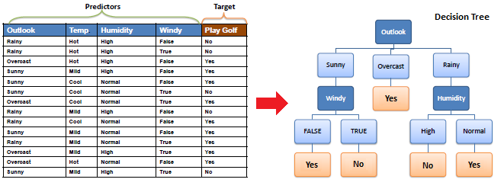
Decision Tree Classifier

Slide 42
Key requirements
Attribute-value description:
object or case must be expressible in terms of a fixed collection of properties or attributes (e.g., hot, mild, cold).
Predefined classes (target values):
the target function has discrete output values (Boolean or multiclass)
Sufficient data:
enough training cases should be provided to learn the model (induction).

Slide 43
A simple example…
You want to guess the outcome (target class) of next week's game between the Liverpool and Manchester United.
Available knowledge / attributes / features / properties
was the game at Home or Away
was the starting time 5pm, 7pm or 9pm.
did Joe play center, or forward.
whether that opponent's center was tall or not.
…..

Slide 44
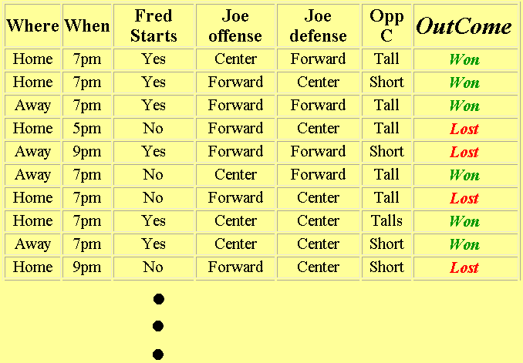
Data: Outcome = Liverpool won or lost?

Slide 45
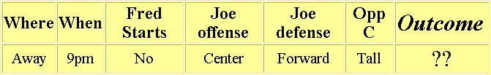
What we know
Test case: The game will be away, at 9pm, and that Joe will play center on offence…
A classification problem
Generalizing the learned rule (predictive model) to new examples

Slide 46
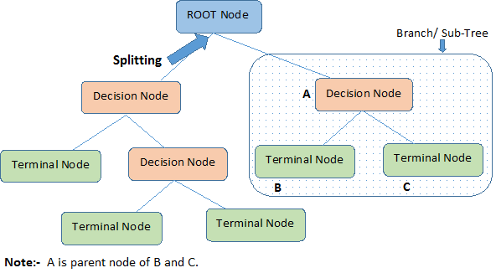
Terminologies
Decision trees classify instances or examples by starting at the root of the tree and moving through it until a leaf node.
Decision tree is a classifier in the form of a tree structure
Decision node: specifies a test on a single attribute
Leaf/ Terminal node: indicates the value of the target attribute
Splitting: It is a process of dividing a node into two or more sub-nodes.
Arc/edge: split of one attribute
Path: a disjunction / alternation of test to make the final decision
Pruning: When we reduce the size of decision trees by removing nodes (opposite of Splitting).
Notes:
https://medium.com/@rishabhjain_22692/decision-trees-it-begins-here-93ff54ef134

Slide 47
Example of a Decision Tree

Slide 48

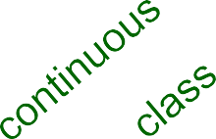
Another Example of Decision Tree
MarSt
Single,
Divorced
Married
Tid | Refund | Marital Status | Taxable Income | Cheat
1 | Yes | Single | 125K | No
2 | No | Married | 100K | No
3 | No | Single | 70K | No
4 | Yes | Married | 120K | No
5 | No | Divorced | 95K | Yes
6 | No | Married | 60K | No
7 | Yes | Divorced | 220K | No
8 | No | Single | 85K | Yes
9 | No | Married | 75K | No
10 | No | Single | 90K | Yes
NO
Refund
Yes
No
NO
TaxInc
< 80K
> 80K
NO
YES
Decision Tree Induction (Model Training): There could be more than one tree that fits the same data!
10

Slide 49
Decision Tree Classification Task

Slide 50
Apply Model to Test Data: Deduction

Slide 51
Apply Model to Test Data
Refund
Marital Status
Taxable Income
Cheat
No
Married
80K
?
Refund
10
Yes
No
NO
MarSt
Single, Divorced
Married
TaxInc
NO
< 80K
> 80K
NO
YES

Slide 52
Apply Model to Test Data
Refund
Marital Status
Taxable Income
Cheat
No
Married
80K
?
Refund
10
Yes
No
NO
MarSt
Single, Divorced
Married
TaxInc
NO
< 80K
> 80K
NO
YES

Slide 53
Apply Model to Test Data
Refund
Marital Status
Taxable Income
Cheat
No
Married
80K
?
Refund
10
Yes
No
NO
MarSt
Single, Divorced
Married
TaxInc
NO
< 80K
> 80K
NO
YES

Slide 54
Apply Model to Test Data
Refund
Marital Status
Taxable Income
Cheat
No
Married
80K
?
Refund
10
Yes
No
NO
MarSt
Single, Divorced
Married
TaxInc
NO
< 80K
> 80K
NO
YES

Slide 55
Apply Model to Test Data
Refund
Marital Status
Taxable Income
Cheat
No
Married
80K
?
Refund
10
Yes
No
NO
MarSt
Married
Assign Cheat to “No”
Single, Divorced
TaxInc
NO
< 80K
> 80K
NO
YES

Slide 56
Decision Tree Classification Task: Induction

Slide 57
Decision Tree Induction (Splitting) Algorithms
How to split the tree to form the model?
Hunt’s Algorithm (one of the earliest)
C4.5 (one of the most popular classifiers of all time) by Ross Quinlan
Iterative Dichotimiser 3 (ID3) (precursor to the C4.5) by Ross Quinlan
Classification And Regression Trees (CART) (independently invented around the same time as C4.5)
SLIQ
SPRINT
Notes:
CART: https://machinelearningmastery.com/classification-and-regression-trees-for-machine-learning/
ID3: https://en.wikipedia.org/wiki/ID3_algorithm
C4.5: https://en.wikipedia.org/wiki/C4.5_algorithm
SLIQ: https://sci2s.ugr.es/keel/pdf/algorithm/congreso/SLIQ.pdf
SPRINT: www.vldb.org/conf/1996/P544.PDF

Slide 58
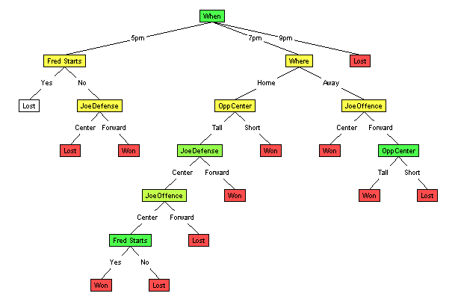
Random Split
The tree can grow huge.
These trees are hard to understand.
Larger trees are typically less accurate than smaller trees (overfitting)
high dimensionality --> curse of dimensionality

Slide 59
Hunt's Algorithm
The decision tree is constructed in a recursive fashion until each path ends in a pure subset (by this we mean each path taken must end with a class chosen).
3 steps that are done until the tree is fully grown (every leaf node represent a homogeneous subset, i.e. a class):
Examine the record data and find the best attribute for the first node.
Split the record data based on this attribute.
Recurse on each corresponding child node choosing other attributes.
Notes:
http://mines.humanoriented.com/classes/2010/fall/csci568/portfolio_exports/lguo/decisionTree.html
http://www.hypertextbookshop.com/dataminingbook/working_version/contents/chapters/chapter001/section003/blue/page004.html

Slide 60
Structure of Hunt's Algorithm
Tid | Refund | Marital Status | Taxable Income | Cheat
1 | Yes | Single | 125K | No
2 | No | Married | 100K | No
3 | No | Single | 70K | No
4 | Yes | Married | 120K | No
5 | No | Divorced | 95K | Yes
6 | No | Married | 60K | No
7 | Yes | Divorced | 220K | No
8 | No | Single | 85K | Yes
9 | No | Married | 75K | No
10 | No | Single | 90K | Yes
Let D_{t} be the set of training records that reach a node t
General Procedure:
If D_{t} contains records that belong to the same class y_{t}, then t is a leaf node labeled as y_{t}
If D_{t} is an empty set, then t is a leaf node labeled by the default class, y_{d}
If D_{t} contains records that belong to more than one class, use an attribute test to split the data into smaller subsets (to create more leaves).
Recursively apply the procedure to each subset.
10
D
t
?

Slide 61
Hunt's Algorithm
Tid | Refund | Marital Status | Taxable Income | Cheat
1 | Yes | Single | 125K | No
2 | No | Married | 100K | No
3 | No | Single | 70K | No
4 | Yes | Married | 120K | No
5 | No | Divorced | 95K | Yes
6 | No | Married | 60K | No
7 | Yes | Divorced | 220K | No
8 | No | Single | 85K | Yes
9 | No | Married | 75K | No
10 | No | Single | 90K | Yes
Refund
Don’t
Cheat
Yes
No
(default class, y_{d})
Don’t Cheat
Don’t
Cheat
Refund
Refund
Yes
No
Yes
No
Don’t Cheat
Don’t Cheat
Marital Status
10
Marital Status
Single, Divorced
Single, Divorced
Married
Married
Cheat
Don’t Cheat
Taxable Income
Don’t Cheat
(leaf class, y_{t})
< 80K
>= 80K
Don’t
Cheat
Cheat

Slide 62
Decision Tree Induction
Greedy strategy
Split the records based on an attribute test that optimizes certain criterion.
Issues
Determine how to split the records (induction)?
How to specify the attribute test condition?
How to determine the best split?
Determine when to stop splitting?
At what point do you decide to stop the tree-growing process?
(One might assume that all we need to is to allow the recursive steps play out all the way through to the end but this might prove counterproductive and might be fruitless.)

Slide 63
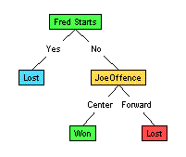
Issues: Illustration
(1) Which to start? (root)
(2) Which node to proceed?
(3) When to stop/ come to conclusion?

Slide 64
How to Specify Test Condition (how to split)?
Depends on attribute (data) types (Chapter 2)
Nominal
Ordinal
Continuous
Depends on number of ways to split
2-way split
Multi-way split

Slide 65
Splitting Based on Nominal Attributes
Multi-way split:
Use as many partitions as distinct values.
Binary split:
Divides values into two subsets.
Need to find optimal partitioning.

Slide 66
Splitting Based on Ordinal Attributes
Multi-way split:
Use as many partitions as distinct values.
Binary split:
Divides values into two subsets.
Need to find optimal partitioning.
What about this split?

Slide 67
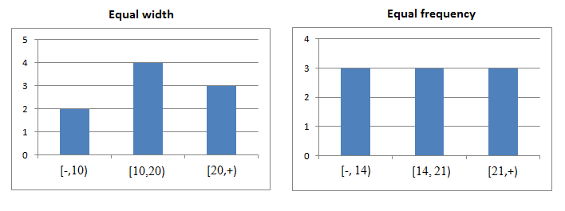
Splitting Based on Continuous Attributes
Discretization to form an ordinal, categorical attribute
Static – discretize once at the beginning
Dynamic – ranges can be found by equal interval/width bucketing/binning, equal frequency bucketing (percentiles), or clustering (interval varies based on cluster).
Binary Decision: (A < v) or (A ≥ v)
consider all possible splits and finds the best cut (what is v?)
can be more computationally intensive.
Notes:
equal interval bucketing / classification method divides attribute values into equal size ranges. the number of records that fall into each category (or bin) will differ.
equal frequency bucketing (percentiles): equal width
https://www.saedsayad.com/unsupervised_binning.htm

Slide 68
Splitting Based on Continuous Attributes

Slide 69
Decision Tree Induction: Issues
Determine how to split the records?
How to specify the attribute test condition?
How to determine the best split?
Determine when to stop splitting?
At what point do you decide to stop the tree-growing process?
(One might assume that all we need to is to allow the recursive steps play out all the way through to the end but this might prove counterproductive and might be fruitless.)
Notes:
http://www.hypertextbookshop.com/dataminingbook/working_version/contents/chapters/chapter001/section003/blue/page004.html

Slide 70
How to determine the best split? Principle Criterion
Selection of an attribute to test at each node - choosing the most useful attribute for classifying examples.
Information gain / Impurity
Measures how well a given attribute separates the training examples according to their target classification
This measure is used to select among the candidate attributes at each step while growing the tree

Slide 71
How to determine the best split?

Slide 72
How to determine the best split?
Greedy approach:
Nodes with homogeneous class distribution are preferred (most or all the of the samples belongs to one class)
Need a measure of node impurity:

Slide 73
Measure of Node Impurity
Gini Index - used in the CART algorithm
Entropy
Gain ratio - used in the C4.5 algorithm
Information gain - used in the ID3 algorithm
Misclassification error
Notes:
https://people.revoledu.com/kardi/tutorial/DecisionTree/how-to-measure-impurity.htm

Slide 74
Measure of Impurity: GINI
Gini Index for a given node t:
(NOTE: p( j|t) is the relative frequency of class j at node t)
The lower the better:
Maximum (1 - 1/n_{c}) when records are equally distributed among all classes, implying least interesting information (least information gain, highest impurity).
Minimum (0.0) when all records belong to one class, implying most interesting information (most information gain, least impurity).

Slide 75
Example for Computing GINI Index

Slide 76
Binary Target Variable: Worked out Example
Consider an example where target variable is binary

Slide 77
Nominal Target Variable: Worked out Example
When target variable is nominal variable with different levels.
In India, there are number of different cuisines available and people have different food preferences.
We have considered a few options and the table below shows proportion of people with their food preferences.

Slide 78
Splitting Based on GINI
Used in CART, SLIQ, SPRINT decision tree induction algorithms.
When a node p is split into k partitions (children), the quality of split is computed as
where
n_{i} = number of records at child i
n = number of records at node p
The higher the value of Gini (on split), the higher the homogeneity (lower impurity)
Notes:
https://medium.com/@rishabhjain_22692/decision-trees-it-begins-here-93ff54ef134

Slide 79
Computing GINI of a split
Gini on split, GINI(s,n) = GINI(n) – P_{L} GINI (n_{L}) – P_{R} GINI (n_{R})
where
s: split
n: node
GINI(n): Gini Index of input node p
P_{L}: Proportion of observation in Left Node after split, s
GINI(n_{L}): Gini of Left Node after split, s
P_{R}: Proportion of observation in Right Node after split, s
GINI(n_{R}): Gini of Right Node after split, s

Slide 80
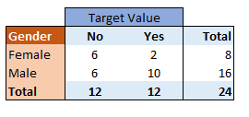
Computing GINI of a split: Example (1)
Banks and financial institutions grant credit facility after evaluating credit risk involved. Credit risk involved in credit decisions is evaluated using Credit Scorecard.
The last 2 years of customer performance on meeting credit obligations is available with us. We want to understand the variable(s) explains high risk of customers who defaulted on a credit facility given to them.
The sample has 24 customers and only customer age and gender are considered.
Age is a continuous variable and Gender is nominal variable.
Input sample has 12 customers who have defaulted on the credit facility. So, default rate is 50%.

Slide 81
Computing GINI of a split: Example (2)
Input node or parent node, has equal number of Target variable values- “Yes” and “No”.
Overall number of observations are 24.
GINI(n) = 1- (1/2)²–(1/2)²
= 1- 0.25 -0.25 = 0.5
Now we want to split the node based on Gender Variable.
After the split we will have following summary.

Slide 82
Computing GINI of a split: Example (3)
Let’s calculate GINI index of the split using Gender variable.
GINI(n_{L}) (female)
= 1- (6/8)² – (2/8)²
= 1- 0.5625 -0.0625
= 0.375
GINI(n_{R}) (male)
= 1- (6/16)² – (10/16)²
= 1 - 0.140625 -0.390625
= 0.469
GINI(s,n) = GINI(n) – P_{L} GINI (n_{L}) – P_{R} GINI (n_{R})
GINI (s,n) = 0.5 – (8/24)*0.375 – (16/24)*0.469
= 0.5 - 0.125 - 0.313 = 0.0625

Slide 83
Computing GINI of a split: Example (4)
Similarly, we need to find GINI index value for all the split points and select the best split for a variable (with the smallest GINI(s,n))
Also the best split points are calculated for all the variables.
The best variable and the split is selected to split the input node.

Slide 84
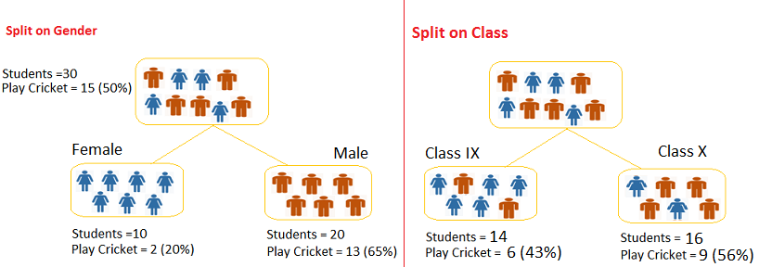
Computing GINI of a split: Cricket Example
We want to segregate the students based on target variable (playing cricket or not ). In the snapshot below, we split the population using two input variables Gender and Class. Now, we want to identify which split is producing more homogeneous sub-nodes using Gini index.

Slide 85
Computing GINI of a split: Cricket Example
Assuming GINI(n) is the same for parent nodes for both cases, we just work on the [P_{L} GINI (n_{L}) + P_{R} GINI (n_{R})] part, the higher the better in this case.
Split on Gender:
Gini for sub-node Female = (0.2)*(0.2)+(0.8)*(0.8)=0.68
Gini for sub-node Male = (0.65)*(0.65)+(0.35)*(0.35)=0.55
Weighted Gini for Split Gender = (10/30)*0.68+(20/30)*0.55 = 0.59
Split on Class:
Gini for sub-node Class IX = (0.43)*(0.43)+(0.57)*(0.57)=0.51
Gini for sub-node Class X = (0.56)*(0.56)+(0.44)*(0.44)=0.51
Weighted Gini for Split Class = (14/30)*0.51+(16/30)*0.51 = 0.51
The Gini score for Split on Gender is higher than Split on Class, hence, the node split will take place on Gender.

Slide 86
Computing GINI of a split: Example

Slide 87
Summary: Steps to Calculate Gini for a split
Calculate Gini for sub-nodes (children), using formula
Calculate Gini for split using weighted Gini score of each node of that split, GINI(s,n) = GINI(n) – P_{L} GINI (n_{L}) – P_{R} GINI (n_{R})

Slide 88
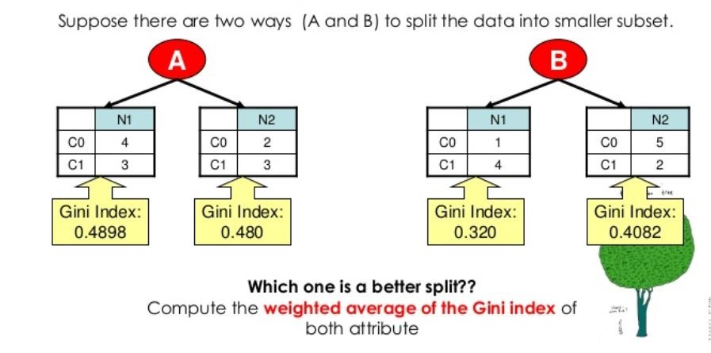
Computing GINI of a split
Splits into two partitions
Effect of weighing partitions: larger and purer partitions are sought for.
Try: Compute the GINI(s,n) assuming GINI(n) is the same for way A and B?
Notes:
http://dni-institute.in/blogs/gini-index-work-out-example/

Slide 89
Categorical Attributes: Computing GINI Index
For each distinct value, gather counts for each class in the dataset
Use the count matrix to make decisions
Two-way split
(find best partition of values)
Multi-way split
 | CarType
 | Family | Sports | Luxury
C1 | 1 | 2 | 1
C2 | 4 | 1 | 1
Gini | 0.393
 | CarType
 | {Sports, Luxury} | {Family}
C1 | 3 | 1
C2 | 2 | 4
Gini | 0.400
 | CarType
 | {Sports} | {Family, Luxury}
C1 | 2 | 2
C2 | 1 | 5
Gini | 0.419

Slide 90
Continuous Attributes: Computing GINI Index
Use Binary Decisions based on one value
Several Choices for the splitting value
Number of possible splitting values = Number of distinct values
Each splitting value has a count matrix associated with it
Class counts in each of the partitions, A < v and A ≥ v
Simple method to choose best v
For each v, scan the database to gather count matrix and compute its Gini index
Computationally inefficient! Repetition of work.

Slide 91
Continuous Attributes: Computing GINI Index
For efficient computation:
For each attribute,
Sort the attribute on values
Linearly scan these values, each time updating the count matrix and computing gini index
Choose the split position that has the least gini index

Slide 92
Alternative Splitting Criteria based on Entropy
Entropy at a given node t:
(NOTE: p( j | t) is the relative frequency of class j at node t).
Measures homogeneity of a node (the smaller the better):
Maximum (log n_{c}) when records are equally distributed among all classes implying least information (not homoegeneous)
Minimum (0.0) when all records belong to one class (but not the other) implying most information (homogeneous)
Entropy based computations are conceptually similar to the GINI index computations

Slide 93
Example of Computing Entropy

Slide 94
Computing Entropy: Example 2
Suppose S has 25 examples, 15 positive and 10 negatives [15+, 10-].
Then the entropy of S relative to this classification is
E(S)=-(15/25) log₂(15/25) - (10/25) log₂ (10/25)
= -(0.6)(-0.74) - (0.4) (-1.32)
= 0.444 + 0.528
= 0.972

Slide 95
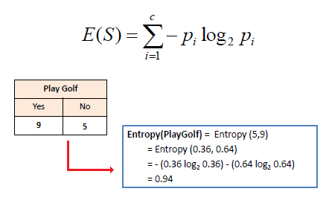
Entropy using the frequency table of one attribute: Example
Notes:
https://www.saedsayad.com/decision_tree.htm

Slide 96
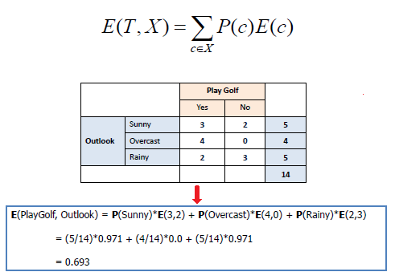
Entropy using the frequency table of two attributes (weighted): Example
Notes:
https://www.saedsayad.com/decision_tree.htm

Slide 97
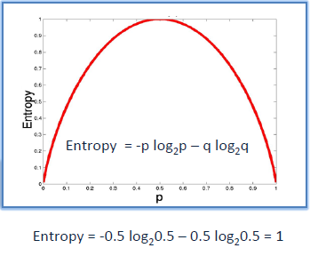
Intuitions
The entropy is 0 if the outcome is ``certain’’ (homogeneous).
The entropy is maximum (~1) if we have no knowledge of the system (or any outcome is equally possible, “uncertain”).
The lower the better.

Slide 98
Splitting based on Information Gain
Information Gain:
Measures the expected reduction in entropy (“uncertainty”) achieved because of the split.
Used in ID3 and C4.5
The first term (Entropy(p)) in the equation for Gain is just the entropy of the original collection p
The second term is the expected value of the entropy after p is partitioned into k partitions using attribute A.
Choose the split that achieves most reduction in entropy (maximizes GAIN)
Disadvantage: Tends to prefer splits that result in large number of partitions, each being small but pure.

Slide 99
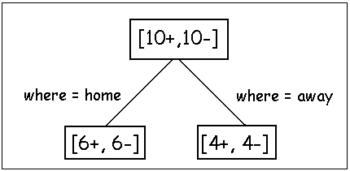
Example of Computing Information Gain
Before partitioning, the entropy is
H(10/20, 10/20) = - 10/20 log(10/20) - 10/20 log(10/20) = 1
Using the ``where’’ attribute, divide into 2 subsets
Entropy of the first set, H(home) = - 6/12 log(6/12) - 6/12 log(6/12) = 1
Entropy of the second set, H(away) = - 4/8 log(6/8) - 4/8 log(4/8) = 1
Expected entropy after partitioning
12/20 * H(home) + 8/20 * H(away)
= 12/20 *1 + 8/20 * 1
= 1
Information Gain = 1 - 1 = 0 (after the split, no reduction in entropy, no information gain, high uncertainty)

Slide 100
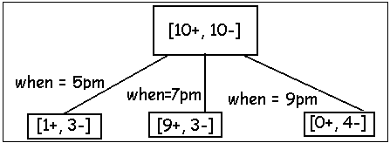
Example of Computing Information Gain
Using the ``when’’ attribute, divide into 3 subsets
Entropy of the first set, H(5pm)
= - 1/4 log(1/4) - 3/4 log(3/4) = 0.8113
Entropy of the second set H(7pm)
= - 9/12 log(9/12) - 3/12 log(3/12) = 0.8113
Entropy of the second set H(9pm)
= - 0/4 log(0/4) - 4/4 log(4/4) = 0
Expected (weighted) entropy after partitioning
= 4/20 * H(1/4, 3/4) + 12/20 * H(9/12, 3/12) + 4/20 * H(0/4, 4/4) = 0.65
Information gain 1-0.65 = 0.35

Slide 101
Example of Computing Information Gain: Decision
Knowing the ``when’’ attribute values provides larger information gain than ``where’’.
Therefore the ``when’’ attribute should be chosen for testing prior to the ``where’’ attribute.
Similarly, we can compute the information gain for other attributes.
At each node, choose the attribute the results in the largest information gain.

Slide 102
Splitting based on Gain Ratio
Gain Ratio:
Adjusts Information Gain by the entropy of the partitioning (SplitINFO) (after split).
Used in C4.5
Designed to overcome the disadvantage of Information Gain
Higher entropy partitioning (large number of small partitions) is penalized!

Slide 103
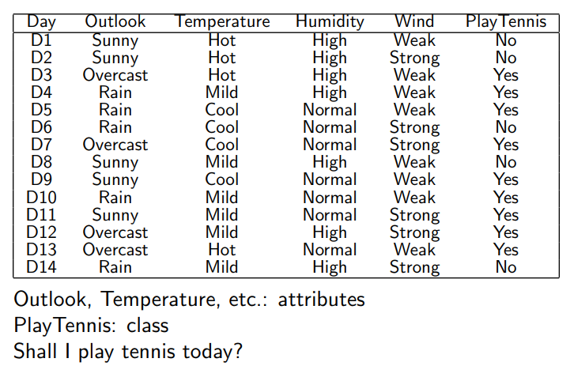
Example of Computing Gain Ratio
Decision
Entropy(Decision)
= ∑ – p(I) . log₂p(I) = – p(Yes) . log₂p(Yes) – p(No) . log₂p(No)
= – (9/14) . log₂(9/14) – (5/14) . log₂(5/14) = 0.940
GainRatio(A) = Gain(A) / SplitInfo(A)
SplitInfo(A) = -∑ |D_{j}|/|D| x log₂|D_{j}|/|D|
Notes:
https://sefiks.com/2018/05/13/a-step-by-step-c4-5-decision-tree-example/
http://ml.informatik.uni-freiburg.de/former/_media/documents/teaching/ss12/ml/03_decisiontrees.printer.pdf

Slide 104
Example of Computing Gain Ratio: (2) Wind Attribute
Gain(Decision, Wind) = Entropy(Decision) – [ p(Decision|Wind=Weak) . Entropy(Decision|Wind=Weak) ] + [ p(Decision|Wind=Strong) . Entropy(Decision|Wind=Strong) ]
There are 8 decisions for weak wind, and 6 decisions for strong wind.
Entropy(Decision|Wind=Weak) = – p(No) . log₂p(No) – p(Yes) . log₂p(Yes) = – (2/8) . log₂(2/8) – (6/8) . log₂(6/8) = 0.811
Entropy(Decision|Wind=Strong) = – (3/6) . log₂(3/6) – (3/6) . log₂(3/6) = 1
Information Gain(Decision, Wind)
= 0.940 – (8/14).(0.811) – (6/14).(1)
= 0.940 – 0.463 – 0.428
= 0.049
SplitInfo(Decision, Wind)
= -(8/14).log₂(8/14) – (6/14).log₂(6/14)
= 0.461 + 0.524
= 0.985
GainRatio(Decision, Wind)
= Gain(Decision, Wind) / SplitInfo(Decision, Wind)
= 0.049 / 0.985 = 0.0497
Notes:
https://sefiks.com/2018/05/13/a-step-by-step-c4-5-decision-tree-example/

Slide 105
Example of Computing Gain Ratio: (3) Outlook Attribute
Gain(Decision, Outlook) = Entropy(Decision) – p(Decision|Outlook=Sunny) . Entropy(Decision|Outlook=Sunny) – p(Decision|Outlook=Overcast) . Entropy(Decision|Outlook=Overcast) – p(Decision|Outlook=Rain) . Entropy(Decision|Outlook=Rain)
There are 5 instances for sunny, 4 instances for overcast and 5 instances for rain
Entropy(Decision|Outlook=Sunny) = – p(No) . log₂p(No) – p(Yes) . log₂p(Yes) = -(3/5).log₂(3/5) – (2/5).log₂(2/5) = 0.441 + 0.528 = 0.970
Entropy(Decision|Outlook=Overcast) = – p(No) . log₂p(No) – p(Yes) . log₂p(Yes) = -(0/4).log₂(0/4) – (4/4).log₂(4/4) = 0
Entropy(Decision|Outlook=Rain) = – p(No) . log2p(No) – p(Yes) . log₂p(Yes) = -(2/5).log₂(2/5) – (3/5).log₂(3/5) = 0.528 + 0.441 = 0.970
Gain(Decision, Outlook) = 0.940 – (5/14).(0.970) – (4/14).(0) – (5/14).(0.970) – (5/14).(0.970) = 0.246
SplitInfo(Decision, Outlook) = -(5/14).log₂(5/14) -(4/14).log₂(4/14) -(5/14).log₂(5/14) = 1.577
GainRatio(Decision, Outlook)
= Gain(Decision, Outlook)/SplitInfo(Decision, Outlook) = 0.246/1.577 = 0.155

Slide 106
Example of Computing Gain Ratio: (4) Humidity Attribute
Humidity is a continuous attribute. We need to convert continuous values to nominal ones.
Firstly, we need to sort humidity values smallest to largest (see Table).
Now, we need to iterate on all humidity values and separate dataset into two parts as instances less than or equal to current value, and instances greater than the current value.
We would calculate the gain or gain ratio for every step. The value which maximizes the gain would be the threshold.

Slide 107
Example of Computing Gain Ratio: (5) Humidity Attribute
Notes:
https://sefiks.com/2018/05/13/a-step-by-step-c4-5-decision-tree-example/

Slide 108
Example of Computing Gain Ratio: (6)
Let’s summarize calculated gain and gain ratios.
Outlook attribute comes with both maximized gain (0.246) and gain ratio (0.155).
This means that we need to put outlook decision in root of decision tree.

Slide 109
Example of Computing Gain Ratio: (7)

Slide 110
Example of Computing Gain Ratio: (8)

Slide 111
Splitting Criteria based on Misclassification Error
Misclassification error at a node t :
Measures misclassification error made by a node:
Maximum (1 - 1/n_{c}) when records are equally distributed among all classes, implying least interesting information (high “uncertainty”)
Minimum (0.0) when all records belong to one class, implying most interesting homogeneous information (homogeneous)

Slide 112
Example of Computing Misclassification Error
Best split

Slide 113
Comparison among Splitting Criteria
For a 2-class problem:

Slide 114
Tree Induction
Greedy strategy.
Split the records based on an attribute test that optimizes certain criterion.
Issues
Determine how to split the records?
How to specify the attribute test condition?
How to determine the best split?
Determine when to stop splitting

Slide 115
Stopping Criteria for Tree Induction
Stop expanding a node when
every attribute has already been included along this path through the tree
the training examples associated with this leaf node all have the same target attribute value (homogeneous, i.e., their Gini index or entropy is 0).
Example on Slide 109 for Outlook = Overcast

Slide 116
Strength
Can generate understandable rules
Provide a clear indication of which attributes are most important for prediction or classification (parents are more important than children)
Can handle continuous and categorical variables
Fast at classifying unknown records (low overhead during learning phase)
Easy to interpret for small-sized trees (without too many partitions)
Accuracy is comparable to other classification techniques for many simple data sets

Slide 117
Weakness
Not so suitable for prediction of continuous attribute.
Perform poorly with many class and small data (high dimensional data → curse of dimensionality)
Computationally expensive to train (model induction):
At each node, each candidate splitting field must be sorted before its best split can be found
In some algorithms, combinations of fields are used and a search must be made for optimal combining weights
Pruning algorithms can also be expensive since many candidate sub-trees must be formed and compared

Slide 118
Conclusion
Classification is a data mining function that assigns items in a collection to target categories or classes. The goal of classification is to accurately predict the target class for each case in the data.
k-NN performs classification by matching the test instance with K training examples and decides its class based on the similarity to K nearest neighbours.

Slide 119
Conclusion
Decision tree induction is the task of taking a set of pre-classified instances as input, deciding which attributes are best to split on, splitting the dataset, and recursing on the resulting split datasets until all training instances are categorized.
Decision tree learning (deduction) uses a decision tree (as a predictive model) to go from observations about an item (represented in the branches) to conclusions about the item's target value (represented in the leaves).

Slide 120
Main References
Harrington, P (2012). Machine Learning in Action. Manning Publications.
Richert, W. and Coelho, L.P. (2013). Building Machine Learning Systems with Python. Packt Publishing.
Witten, I.H, Franck, E, and Hall, M. A. (2011). Data Mining: Practical Machine Learning Tools and Techniques. (3rd ed.). Morgan Kaufmann.
Pang-Ning Tan, Michael Steinbach, Anuj Karpatne, Vipin Kumar (2018). Introduction to Data Mining (2nd Edition), Pearson

Slide 121
Other References
J. Grus (2015). Data Science from Scratch: First Principles with Python. O'Reilly Media.
C. C. Aggarwal. (2015). Data Mining: The Textbook. Springer
Richert, W. and Coelho, L.P. (2013). Building Machine Learning Systems with Python. Packt Publishing.
Russel M.A. (2013). Mining the Social Web: Data Mining Facebook, Twitter, LinkedIn, Google+, GitHub, and More. (2nd Ed). O’Reilly Media.

Slide 122
Online References
k-NN
https://www.geeksforgeeks.org/k-nearest-neighbours/
Decision Tree:
https://www.geeksforgeeks.org/decision-tree/
https://www.geeksforgeeks.org/decision-tree-introduction-example/
https://www.saedsayad.com/decision_tree.htm
https://medium.com/deep-math-machine-learning-ai/chapter-4-decision-trees-algorithms-b93975f7a1f1
https://www.kdnuggets.com/2016/10/decision-trees-concise-technical-overview.html

